Slide 1
USAID Zambia Evidence For Health (E4H)
PRESENTATION ON SELECTED CHILD HEALTH, NUTRITION AND DISEASE INDICATORS - DHIS2 data, 2018- 2021
Zambia Evidence for Health Project
March 2022

Slide 2
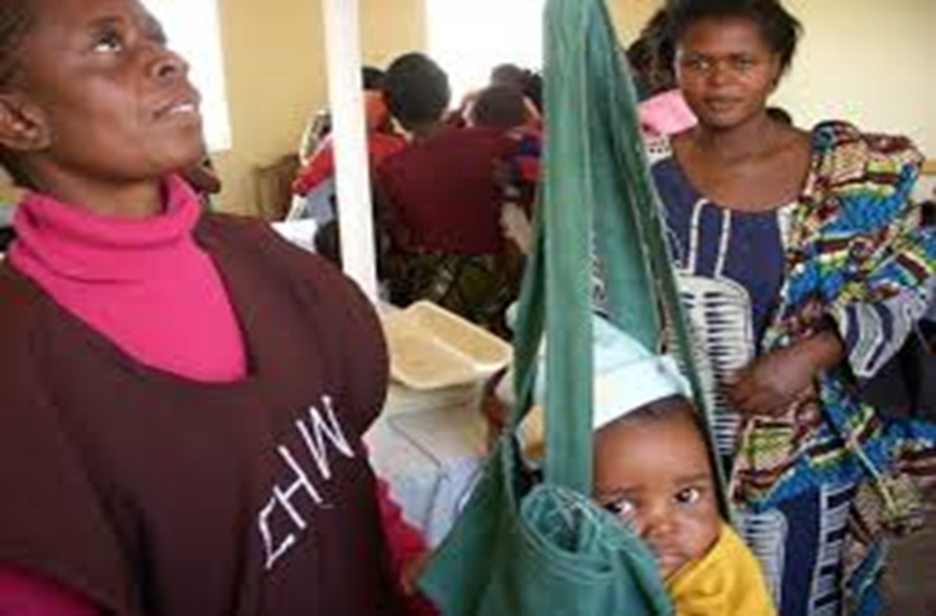
CHILD HEALTH AND NUTRITION
Photo credit: Mellisa Thompson, USAID

Slide 3
Overview of Data Trends 2018 - 2021
Data now covers all of 2021 – will look at cumulative trends since 2018
Categorize data into trending positively, negatively, and remaining consistent
Trends are VERY slight – DO NOT PANIC!
Discussion on stunting and wasting data

Slide 4
Reviewing Data
Changes in trends – always look for any outliers
Understand data strengths and weaknesses
Things to keep in mind for additional data analysis
Look at areas for primary research to look into some trends

Slide 5
Child Health, Nutrition and Disease Dashboard
Negative Trend | No Change | Positive Trend
Measles Coverage under 1 year | Fully immunized coverage under 1 – a slight decrease seen in 2021 | Initiation on breastmilk with one hour of birth
Measles Coverage under 2 years | BCG Coverage for under 1 year | DPT Hib Hep first dose coverage under 1 year
Percent of Children (12-59 months) Dewormed by Province | Infants on EBF at 6 months | Obesity Rate in under 5
Percent of Children who Received a Dose of Vitamin A | Stunting Rate under 5
 | Wasting Rate under 5

Slide 6
Positively Trending

Slide 7
Initiation on breastmilk within one hour of birth (%): 2018 to 2021 Yearly targets vs Achieved
Notes:
Steady increase since 2018 in this indicator, which is positive. Keep in mind though that while the numbers achieved are rising, they are not keeping up with the national targets.

Slide 8
DPT Hib Hep 1st dose coverage (%) under 1 by quarter from 2018 to 2021
Notes:
Seeing these consistent increases in Q3 and Q4 for 2021

Slide 9
Obesity rate (%) in under 5s at facility: 2018 to 2021 Yearly targets vs Achieved
Notes:
Obesity remains on a consistent downward trend and hits the percentage national target of 0%

Slide 10
NO CHANGE

Slide 11
Fully immunized coverage (%) under 1: 2018 to 2021 Yearly targets vs Achieved
Notes:
Interesting to see the target was close in 2020 and has declined slightly in 2021 and is not keeping up with the increased target. So there is not a major change in the numbers but we are moving further from the national target.

Slide 12
BCG coverage for under 1yr : by quarter from 2018 to 2021
Notes:
The BCG coverage remains steady, similar to previous years, fluctuating between 82 and 97%. The lower numbers in July and August may balance out with child health campaigns in November.
Quarter 2 and Q4 usually have higher performance due to child health week campaigns which usually take place then.
Q4 in 2021 did pick up in numbers but sits just a bit below last years totals.

Slide 13
Infants (all) on EBF at 6 months (%) by quarter from 2018 to 2021
Notes:
This figure stays fairly consistent

Slide 14
WASTING AND STUNTING

Slide 15
Wasting and Stunting DHS and DHIS Comparison
Data collection – DHS teams conduct household measurement of children with provided equipment to accurately measure and weigh children under 5
Notes:
DHS shows a trend in wasting and stunting reduction:
Stunting under 5: 2007 45% 2013-2014 40% 2018 35%
Wasting under 5: 2007 5% 2013-2014 6% 2018 4%
DHIS2 shows a lower trend
Stunting at 1.2% in 2018 to .6% in 2021
Wasting is .1% in 2018 to .5% in 2021

Slide 16
Stunting rate (%) in under 5s at facility: 2018 to 2021 Yearly targets vs Achieved

Slide 17
Wasting rates (%) in under 5s at facility: 2018 to 2021 Yearly targets vs Achieved

Slide 18
NEGATIVELY Trending

Slide 19
Measles coverage (%) under 1 year by quarter from 2018 to 2021
Notes:
Similar to immunization data, we see a dip in coverage in Q3 and then an increase in Q4. But in 2021, the Q4 jump was not as much as in 2020.

Slide 20
Measles coverage (%) under 2 years by quarter from 2018 to 2021
Notes:
There was a large outlier in November 2020 campaign data from all the provinces apart from Southern Province

Slide 21
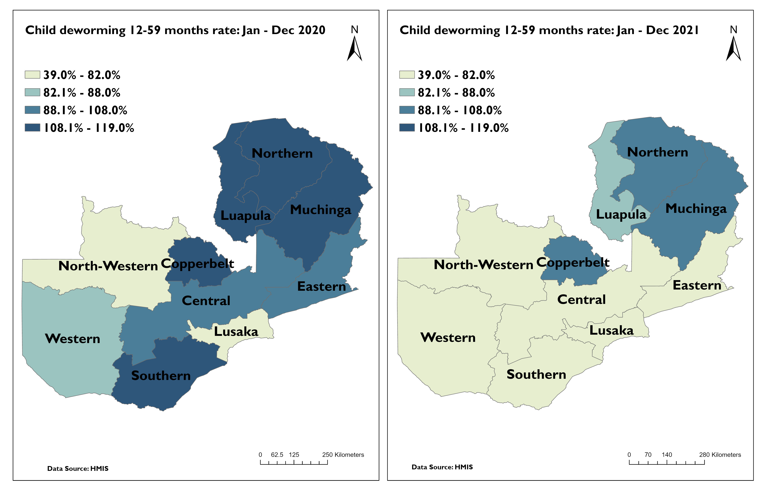
Percent of Children (12-59 months) dewormed by Province
Notes:
Generally, there has been a decrease in coverage across all the provinces. Northwestern and Lusaka has consistently performed below 40% in deworming.

Slide 22
Percent of children who received a dose of Vitamin A by quarter from 2018 to 2021
Notes:
There has been a slight decrease overall in 2021 from previous years – nothing significant but important to keep our eyes on this.

Slide 23
Areas to Follow-Up
Keep an eye on deworming and Vitamin A
Wasting and stunting rates at province level – Central, Copperbelt, Northern, Luapula

